Slide 1
Academic Job Interviews
Get prepared for your career next step !
How to find Academic positions?
When am I ready to apply?
What makes a good application package?
What is the application process? What should I expect?
Join us May 28th 2-3 PM on zoom
When: Friday May 28th 2-3pm via Zoom
Registration: www.pdacalgary.com/upcoming-events
Guests:
Dr. Rebekah Devinney – Cumming School of Medicine
Dr. Julie Menard – Faculty of Veterinary Medicine
Dr. Guillaume Lhermie - The Simpson Centre for Agricultural and Food Innovation and Public Education, The School of Public Policy
Dr. Cheryl Jeffs – Taylor Institute for Teaching and Learning
Dr. Annette Timm – Department of History, Faculty of Arts
Dr. Anirban Chakraborty – Geomicrobiology Group, Department of Biological Sciences

Slide 2
Academic Job Interviews
When: Friday May 28th 2-3pm via Zoom
Registration: www.pdacalgary.com/upcoming-events
May 28th 2-3 PM on zoom

Slide 3
Land acknowledgment
PDAC would like to take this opportunity to acknowledge the traditional territories of people of the Treaty 7 region in Southern Alberta,
The City of Calgary is also home to Métis Nation of Alberta, Region III.
When: Friday May 28th 2-3pm via Zoom
Registration: www.pdacalgary.com/upcoming-events

Slide 4
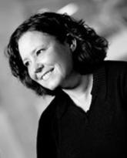
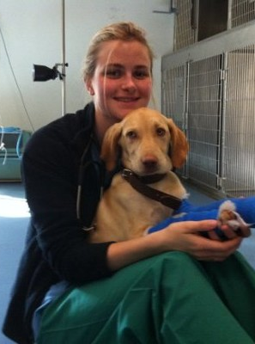
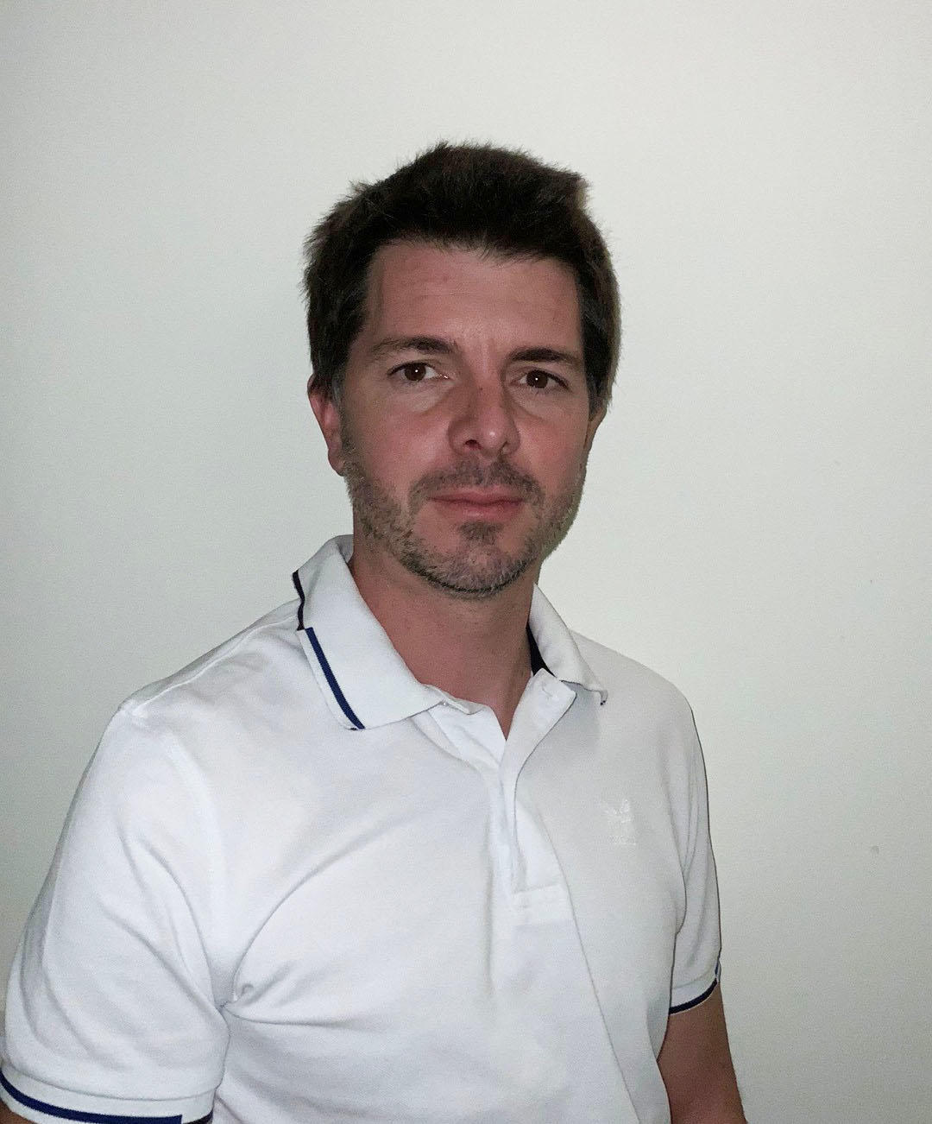
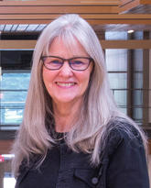
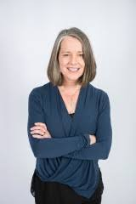
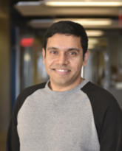
Academic Job Interviews
Dr. Rebekah Devinney
Dr. Julie Menard
Dr. Guillaume Lhermie
When: Friday May 28th 2-3pm via Zoom
Registration: www.pdacalgary.com/upcoming-events
May 28th, 2021
2 PM – 3 PM
Dr. Cheryl Jeffs
Dr. Annette Timm
Dr. Anirban Chakraborty

Slide 5
Academic Job Interviews
May 28th 2-3 PM
Event timeline
Guest introduction
Questions from the attendees => wooclap
Breakout rooms
When: Friday May 28th 2-3pm via Zoom
Registration: www.pdacalgary.com/upcoming-events

Slide 6
Dr. Anirban Chakraborty, PhD
Research associate
Geomicrobiology Group
Energy Bioengineering and Geomicrobiology
Email
anirban.chakraborty@ucalgary.ca
Phone
Office: +1 (403) 210-7167
When: Friday May 28th 2-3pm via Zoom
Registration: www.pdacalgary.com/upcoming-events
Dr. Chakraborty is starting an assistant professor position soon !
Dr. Anirban Chakraborty

Slide 7
Dr. Rebekah DeVinney, PhD, Associate Professor
Department of Microbiology Immunology and Infectious Diseases
Cumming school of medicine, Health Science Center
Email
rdevinne@ucalgary.ca
Phone
Office : (403)220-4095
Lab: (403)220-8303
When: Friday May 28th 2-3pm via Zoom
Registration: www.pdacalgary.com/upcoming-events
Dr DeVinney’s lab has been running in UCal for 20 years!
Dr. Rebekah DeVnney

Slide 8
Dr. Guillaume Lhermie, DVM, MSc, PhD
Program Director
Simpson Centre for Agricultural and Food Innovation and Public Education, The School of Public Policy/ policyschool.ca
Associate Professor
Production Animal Health, Faculty of Veterinary Medicine/ vet.ucalgary.ca
Email
guillaume.lhermie@ucalgary.ca
Phone
Office: 403.220.6295
When: Friday May 28th 2-3pm via Zoom
Registration: www.pdacalgary.com/upcoming-events
Dr. Lhermie started his appointment in UCalgary recently.
Dr. Guillaume Lhermie

Slide 9
Dr. Julie Menard, DVM, DACVECC, Assistant Professor
Veterinary Clinical & Diagnostic Sciences
Faculty of Veterinary medicine
Email
julie.menard@ucalgary.ca
Phone
Office: 403-210-8834
When: Friday May 28th 2-3pm via Zoom
Registration: www.pdacalgary.com/upcoming-events
Dr Menard just started her assistant professor position in UCalgary.
Previously, Dr. Menard was a lecturer in Cornell University, Ithaca, New York, USA
Dr. Julie Menard

Slide 10
Dr. Cheryl Jeffs, EdD
Educational Development Consultant
Academic & Research Team
Taylor Institute for Teaching and Learning
Email
cljeffs@ucalgary.ca
Phone
Office: 403.220.5868
When: Friday May 28th 2-3pm via Zoom
Registration: www.pdacalgary.com/upcoming-events
During the pandemics, Dr. Jeffs consulted with over 100 individuals developing their dossier, facilitated 10 dossier courses with over 200 participants, and published an open-access online developing your teaching dossier module.
Dr. Cheryl Jeffs

Slide 11
Dr. Annette Timm, PhD
Department of History
Faculty of Arts
E-mail: atimm@ucalgary.ca Office: Social Sciences Building 630 Tel.: 403.220.6411 Fax.: 403.289.8566 website: hist.ucalgary.ca/atimm
When: Friday May 28th 2-3pm via Zoom
Registration: www.pdacalgary.com/upcoming-events
Dr. Timm has sat on five hiring committees and has reviewed approx. 300 job application files.
Editor: Journal of the History of Sexuality
Dr. Annette Timm

Slide 12
Academic Job Interviews
Dr. Rebekah Devinney
Dr. Julie Menard
Dr. Guillaume Lhermie
When: Friday May 28th 2-3pm via Zoom
Registration: www.pdacalgary.com/upcoming-events
May 28th, 2021
2 PM – 3 PM
Dr. Cheryl Jeffs
Dr. Annette Timm
Dr. Anirban Chakraborty

Slide 13
Wooclap
www.wooclap.com/EGNSCE
When: Friday May 28th 2-3pm via Zoom
Registration: www.pdacalgary.com/upcoming-events

